Slide 1
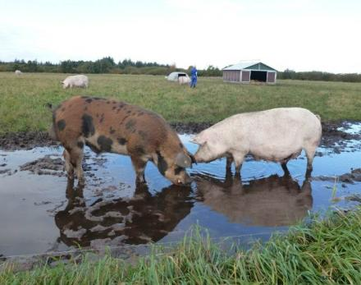
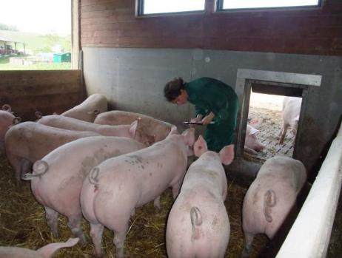
ProPIG
Farm specific strategies to reduce environmental impact by improving health, welfare and nutrition of organic pigs
C. Leeb & ProPIG Consortium
Stockholm, 1st October 2014
Research Seminar

Slide 2
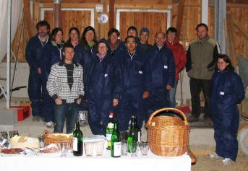
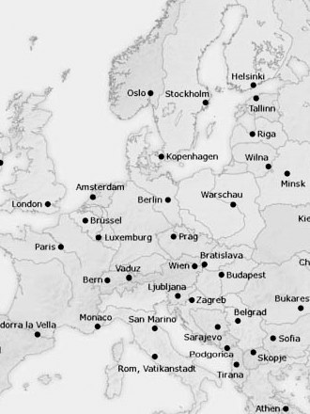
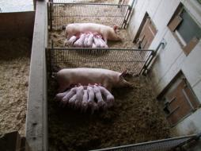
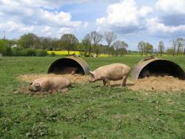
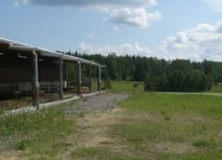
Three Pig Husbandry Systems in Europe
75 farms in 8 countries
To identify
animal - environment interactions in three systems
Hypothesis
all systems are able to ensure good welfare and low environmental impact
when well managed
=?
=?
Indoor with concrete outside run
Outdoor
Partly outdoor

Slide 3
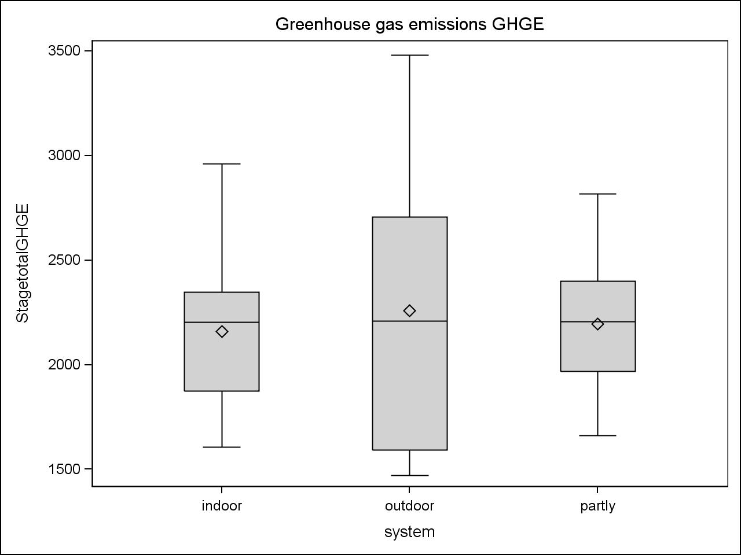
Environment - Greenhouse gas emissions: CO₂-eq in 3 Systems
No statistical difference
GHGE/ 1000kg slaughter pig (Live weight)
Partly outdoor:
Better than outdoor: Eutrophication potential (PO₄-eq.)
Better than indoor: Acidification (SO₂-eq.)
Indoor
(n=24)
Outdoor
(n=10)
Partly
(n=30)
ProPIG Christine Leeb
CoreOrganic Research Seminar, Stockholm, 1st October 2014

Slide 4
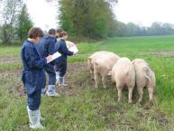
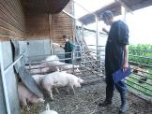
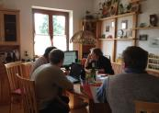
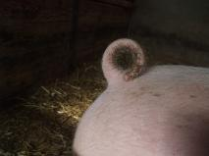
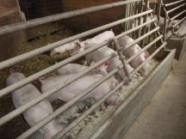
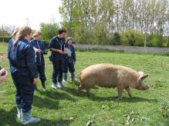
Farm specific strategies for improvement
To develop and implement
Farm specific strategies to:
reduce environmental impacts
by improving health, welfare, nutrition and management of organic pigs
To disseminate knowledge to national advisory bodies and farmers
3. Visit
Assessment
Farm plan
Implementation of measures
2. Visit
Farm plan
1. Visit Assessment

Slide 5
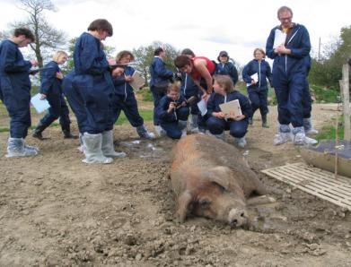
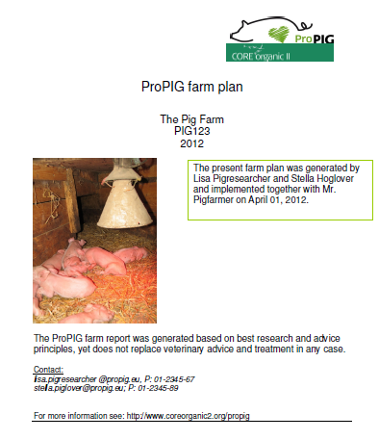
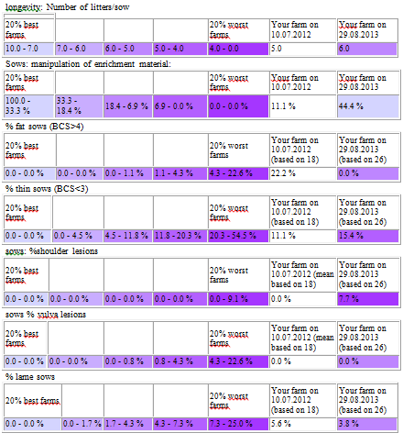
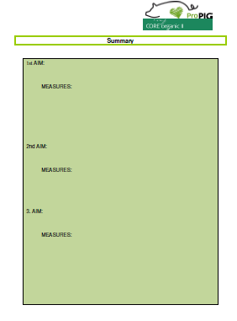
Training & On Farm Improvement
Training and Inter-Observer Agreement
3 Farm visits:
On farm data collection
Feedback to farmer as „Farm plan“ incl. Goals and Measures
Repeat visit to measure effectiveness
PigSurfer
ProPIG Christine Leeb
CoreOrganic Research Seminar, Stockholm, 1st October 2014

Slide 6
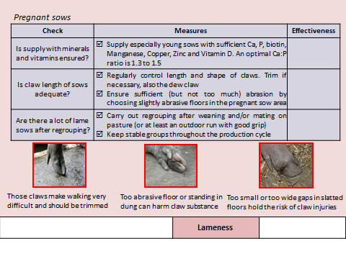
Analysis & Dissemination „Booklet for Improvement“
ProPIG Christine Leeb
CoreOrganic Research Seminar, Stockholm, 1st October 2014

